Slide 1



Day 28
contact@anubhavtrainings.com
ABAP RESTFUL APPLICATION PROGRAMMING

Slide 2

Agenda – Day 28
Sequence Diagram
Implementing Create, Update and Delete
Make field read only
Making field Mandatory
Add validation to the code
Implement Actions - set_status_booked

Slide 3
Fiori App
OData
RAP
B-IMP
Legacy Code
post
Agency customer id
Start date
End date
Create
Create IMPORT
Entities (%cid)
Write to TB
messages
save
Save to DB
cleanup

Slide 4
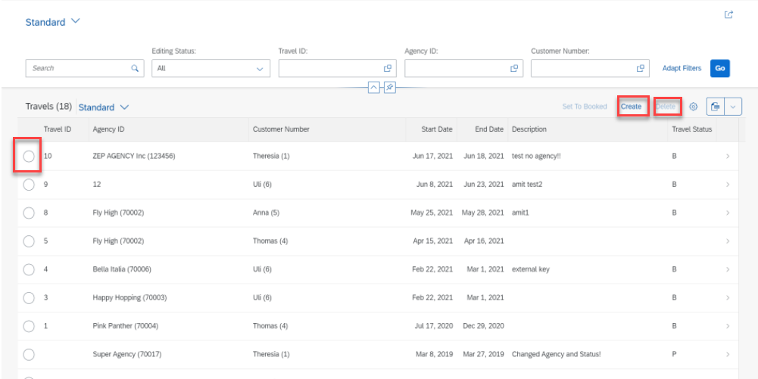
Implementing Create, Update and Delete
For the Functionality of Create ,Update & Delete we Implement the Code in Behavior Definition Class.
Step 1: Click Create Button.

Slide 5
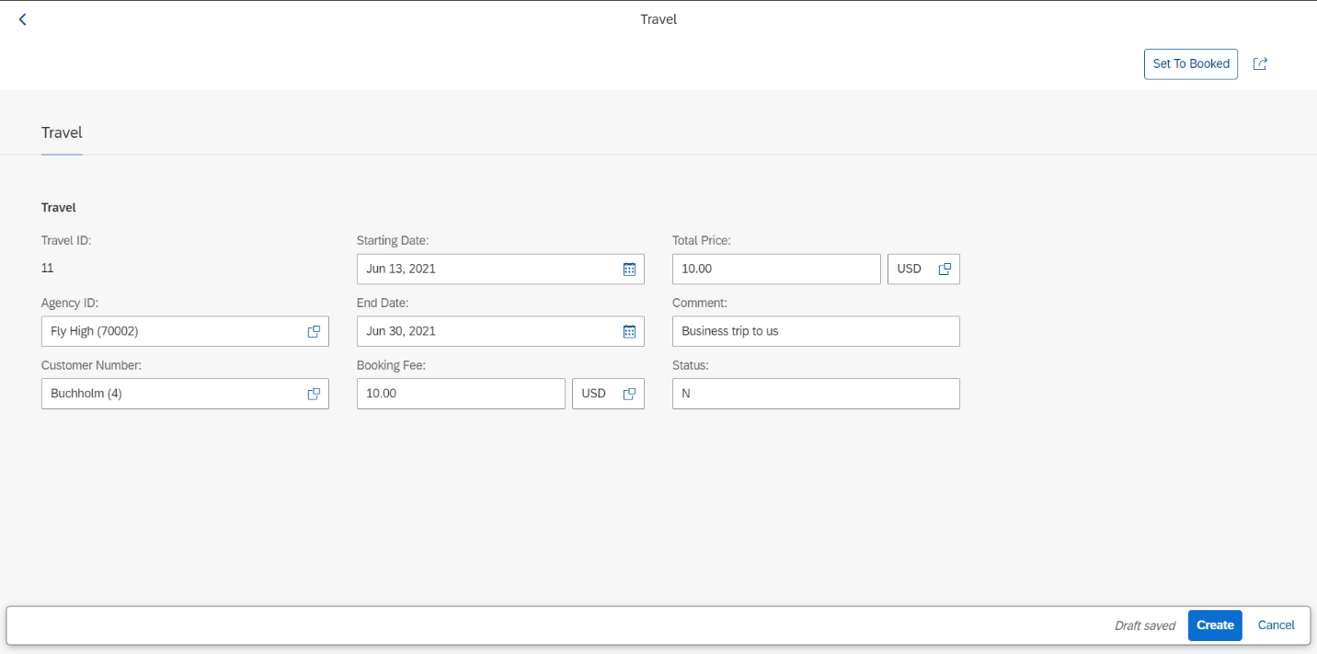
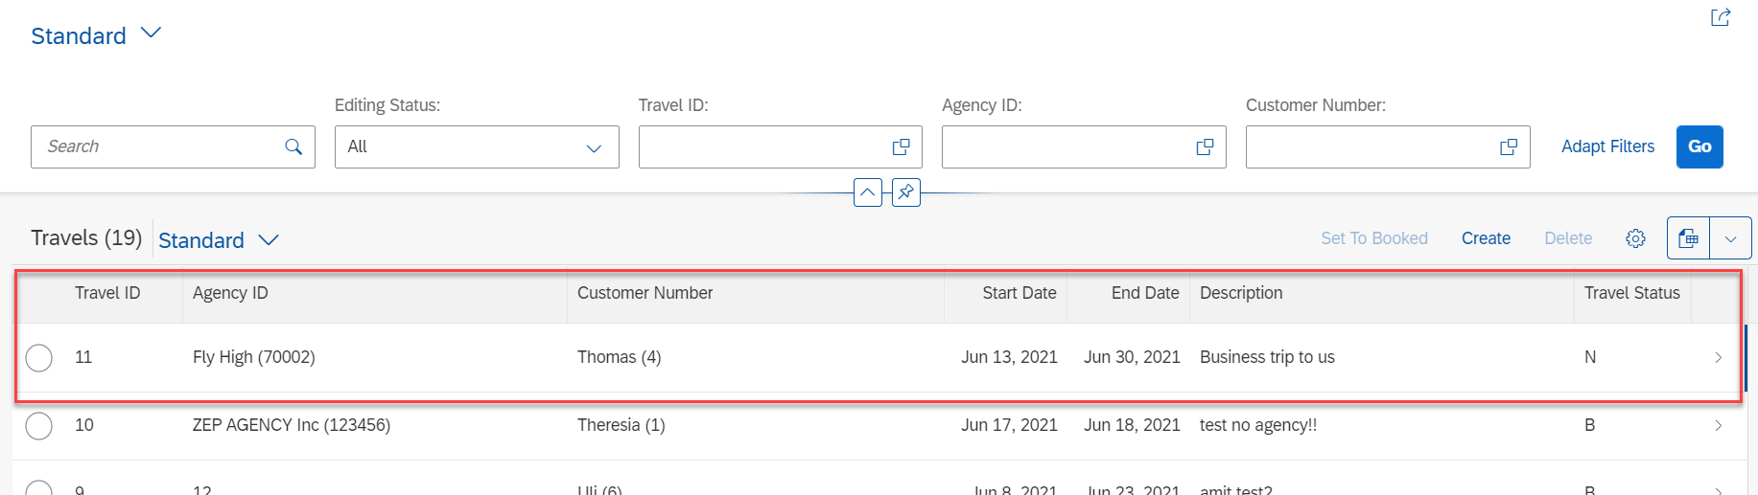
Implementing Create
Step 2: Fill all Correct Entries and Click on Create Button.

Slide 6
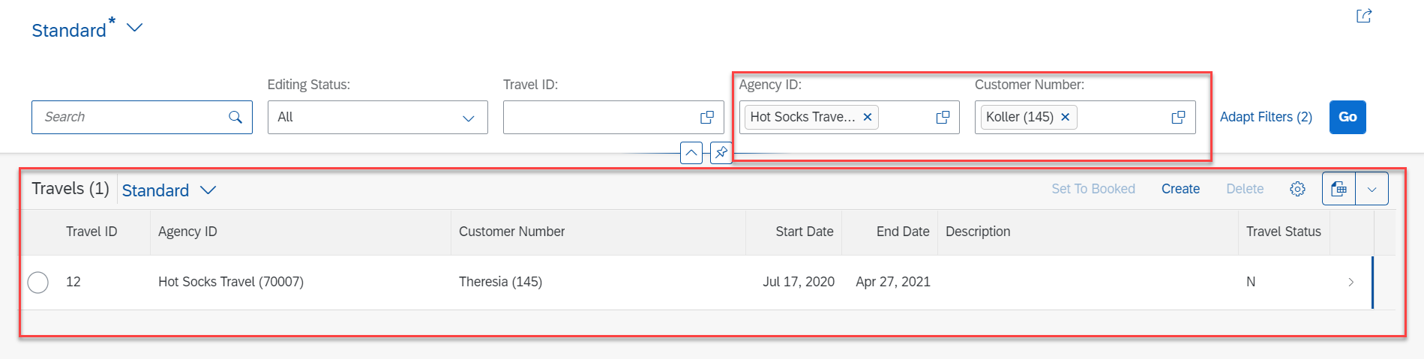
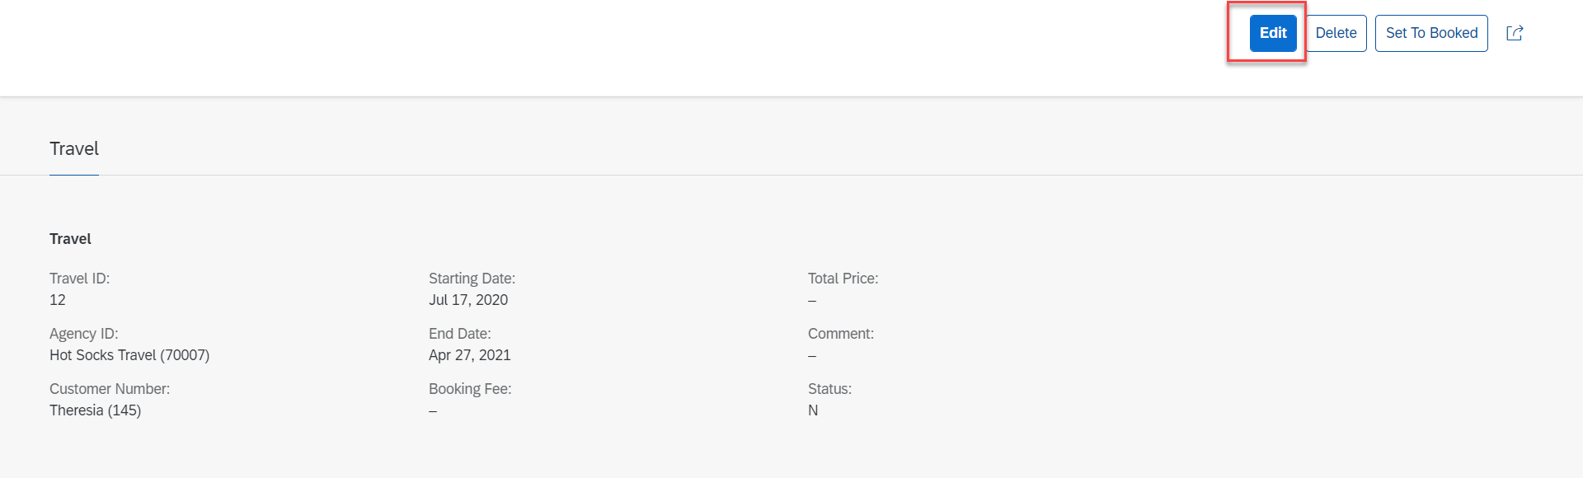
Implementing Update
Step 3: Select a Radio Button and Click Edit Option for Update.

Slide 7
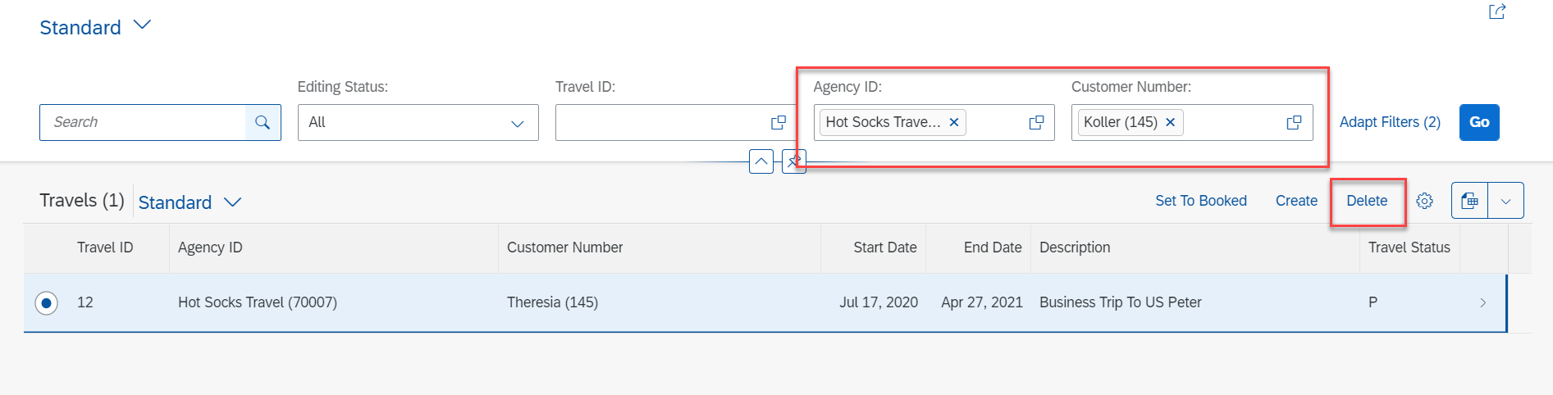
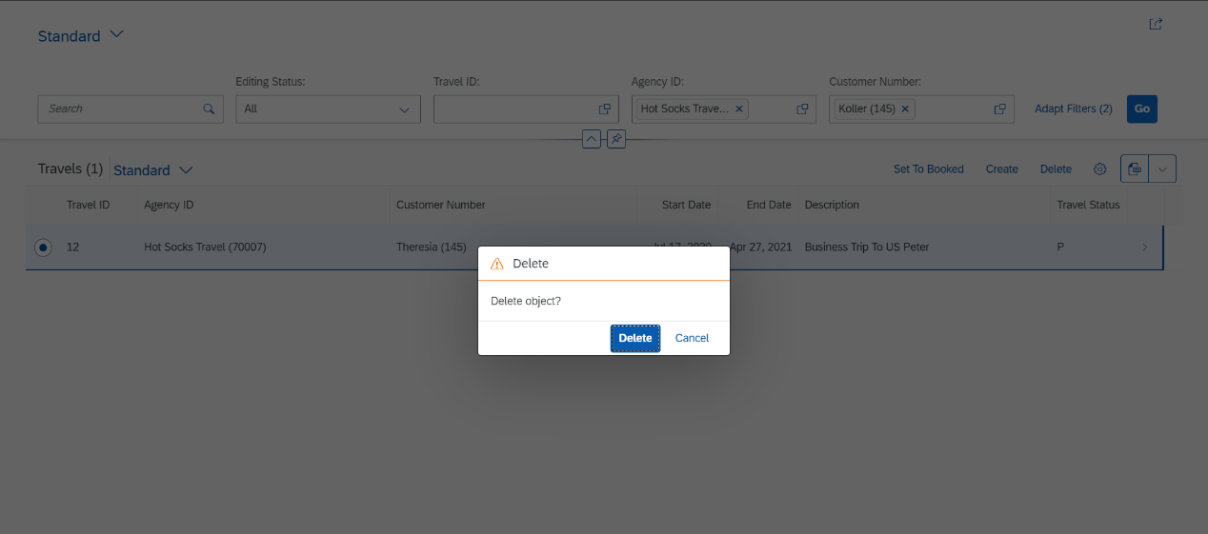
Implementing Delete
Step 4: Select a Radio Button and Click on Delete Button.

Slide 8
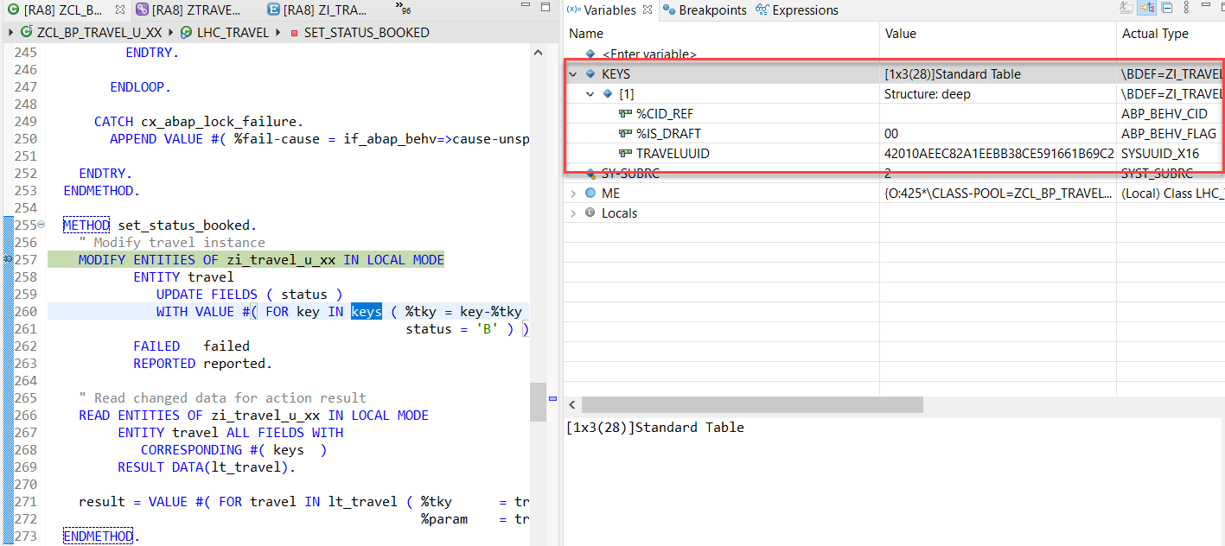
Action Implementation
“Actions” are addition operations in addition to CRUD operations. Are the operations which are non-standard for a business object
Below steps describes the implementation of an action related to the travel instances. Using this action, the end user should be able to change the status of travel processing.
Adding a Type Definition for Import and Export Parameters Required for the Action SET_STATUS_BOOKED
Implementing the Action Handling.

Slide 9
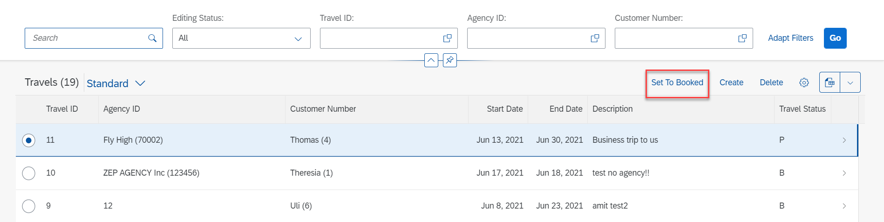
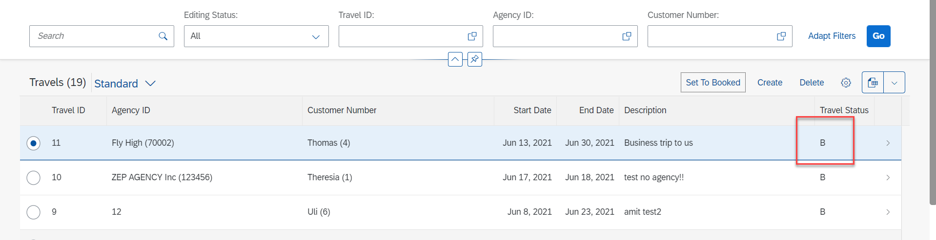
Action Implementation
Select Radio Button and Click on Set To Booked & Travel Status Change to Book (B)

Slide 10
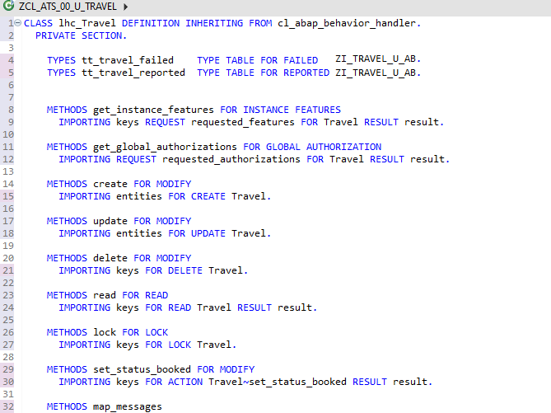
Behavior Pool Logic
Exercise
Behavior Pool Logic

Slide 11

End of Day 28
Trainer: Anubhav Oberoy

Slide 12
Trainer: Anubhav Oberoy

Slide 13
THANK YOU
If you cannot do
great things, do small things in a great way.
Anubhav Oberoy
https://www.anubhavtrainings.com

Slide 14


We’re committed to empower you to be
Most Desirable Resource
through powerful training solutions.
We build the workforce of the future.
250+
Corporate Clients
30,000+
Learners Trained
25000+
Learners Placed
FREE WEBINARS
Sign up for free webinars with industry experts every fortnight!
Enroll Now!
Contact us today!
https://anubhavtrainings.com/

Slide 15




More from AnubhavTrainings.com

